Slide 1

Short-term Rental Cycles
Analysis
Prepared by
Syed Owais Raza

Slide 2

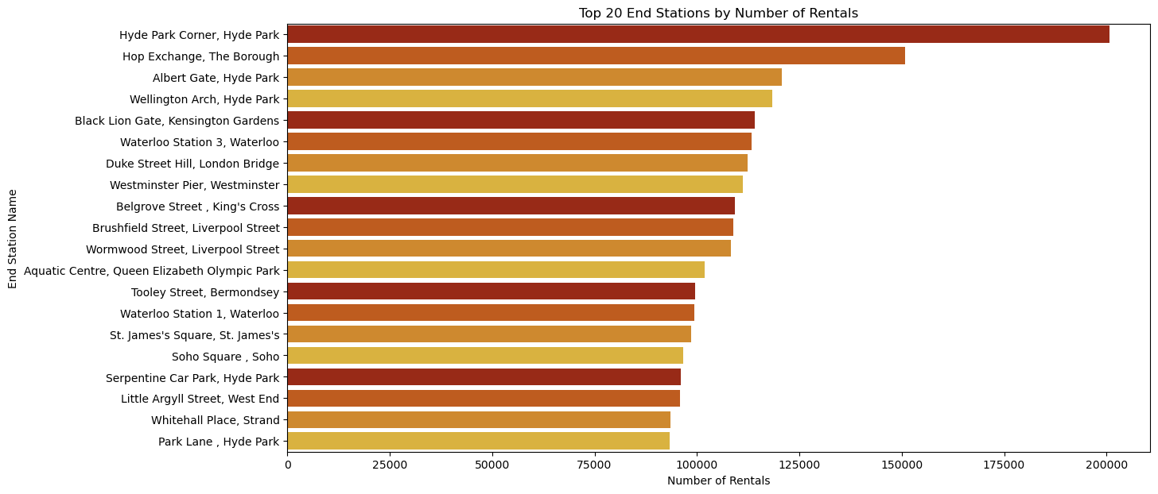
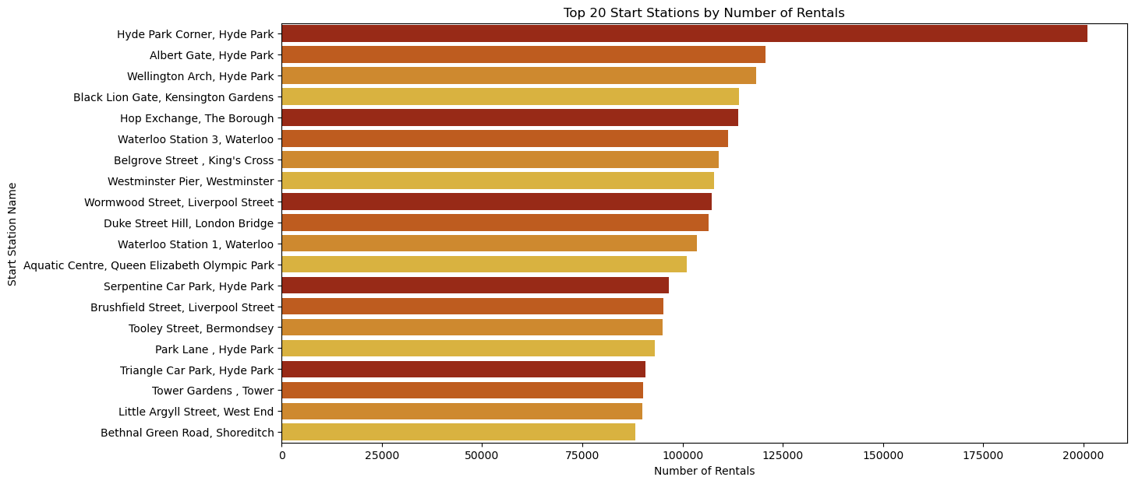
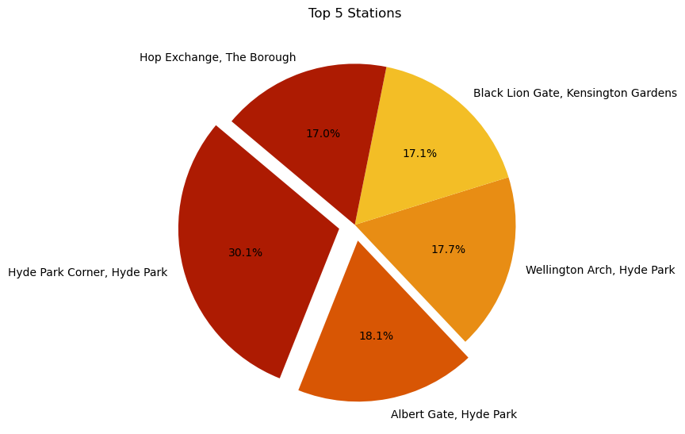
Understanding Bike Rental Dynamic - London
Top 20 End Stations by Number of Rentals
Top 20 Start Stations by Number of Rentals
The top stations for starts and ends are similar, indicating a cycle of rentals that likely begins and ends within the same general locations.
Hyde Park appears to be a central hub for bike rentals, featuring prominently in all three charts along with Waterloo and King's Cross, are high-demand areas.
Top 5 Stations by Number of Rentals

Slide 3
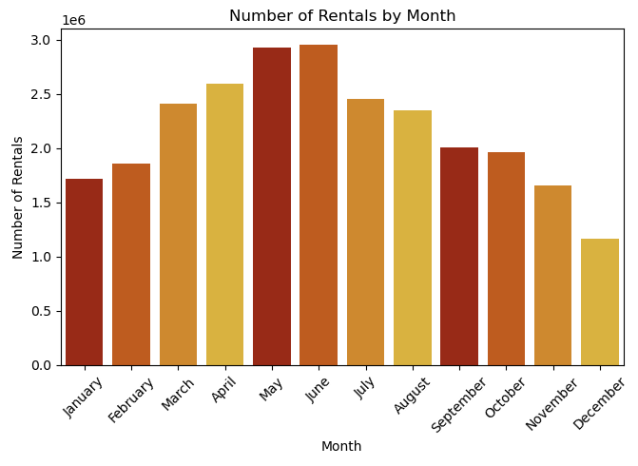
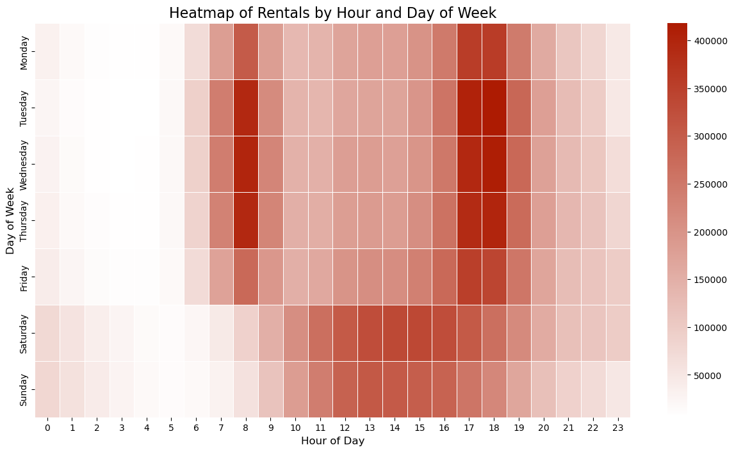
Understanding Bike Rental Dynamic - London
Number of Rentals by Month
Heatmap of Rentals by Hour and Day of Week
This trend likely reflects the impact of weather on bike rentals, with higher numbers in the warmer months and lower numbers in the colder months.
The daily patterns suggest two primary uses: commuting during peak weekday office hours and leisure throughout the day on weekends.

Slide 4
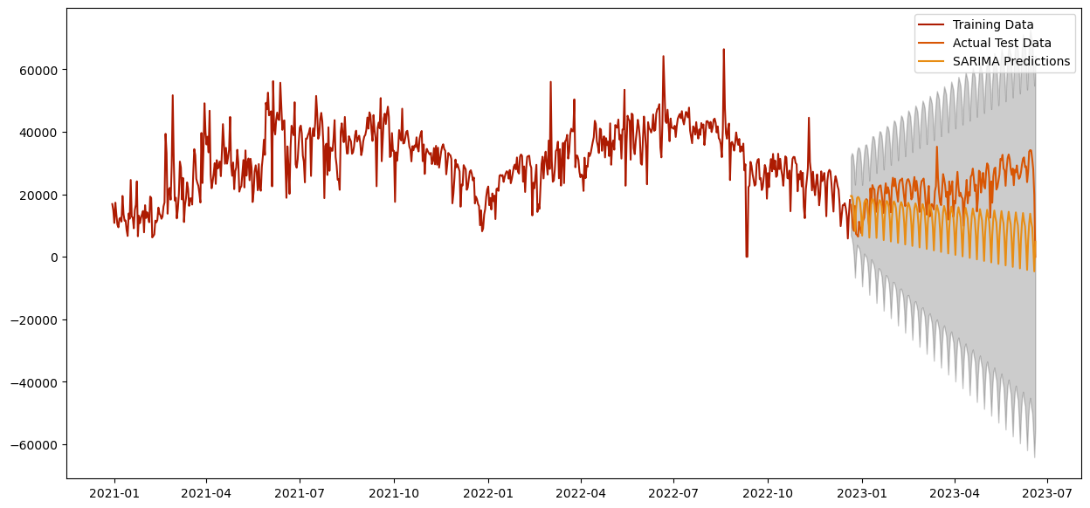
Utilizing Data Science
Data Analysis
The graph shows SARIMA model predictions closely tracking actual demand with increasing uncertainty over time, suggesting a strong basis for short-term planning but greater variability for long-term forecasts.
Demand Forecast using SARIMA Model
Demand Forecasting: Use historical rental data to predict future bike rental demand by time and location to optimize bike distribution.
Customer Segmentation: Analyse rental patterns to segment users into distinct groups for targeted marketing and improved service offerings.
Price Optimization: Develop dynamic pricing models based on demand patterns to maximize revenue and manage peak times efficiently.
Route Optimization: Use rental data to determine the most frequently travelled paths and optimize bike station placement accordingly.
The graph shows SARIMA model predictions closely tracking actual demand with increasing uncertainty over time, suggesting a strong basis for short-term planning but greater variability for long-term forecasts.
User Experience Analysis: Leverage data on rental durations and station popularity to enhance user experience and station amenities.

Slide 5
Recommendation
Customer Profiles and Peak Demand Times
Focus on Commuters: Capitalize on the rush hour demand at 8 am and 5-6 pm on weekdays which are people mostly commuting for work. Offer tailored membership plans for daily commuters to ensure swift and consistent service.
Engage Tourists and Leisure Users: Utilize the steady weekend rental pattern to attract tourists at places like Hyde Park. Curate guided tours and design routes that showcase key attractions, enhancing the leisure cycling experience.
Reliability and Supply Chain Management
Strategic Maintenance Scheduling: Perform intensive maintenance before high-season months, with July being the pinnacle of usage, to guarantee bike availability and service reliability.
Advanced Inventory Management: Implement a dynamic system for live tracking and predictive demand analytics to optimize bike distribution throughout the day.

Slide 6
THANK YOU

